Slide 1
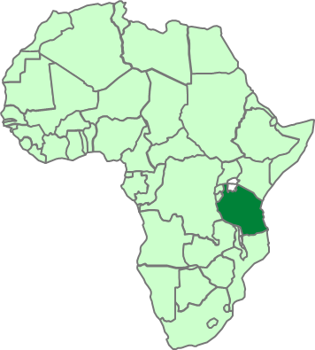


TPCPLC Complaint management System .
Developing complaint management system IT tool 2020
Yusuph Kajela
Promotion and Marketing Officer

Slide 2
Content of the IT tool
Complaint Register
Register complaint
Assign to
Close the complaint
Financial impact
Manage Complaint
Review the complaints by its status
Not processed, Pending complaint, Closed complaints.
Dash board
Report review ,graphs
Account setting
Complaint history

Slide 3

Complaint Register
Register complaint
During registering the complaint you should include the following details
Complaint No. –Can be automatic generated
Customer name
Area or region of the customer –Central,Dar,North ,South ,Zanzibar
Date of complaint received –To be inserted manually
Nature of the Complaint
Details of the complaint
Complaints can be received via

Slide 4
Nature of complaints
The complaint should be clear identified its nature for easy follow ups and we currently group into the following nature
Nature of Complaints
Batch Number Problem | Customer service
Price & bonus | Wrong invoiced
Late delivery | Cement loss due to improper fixing
Quality of cement | Account balance Reconciliation
Quality of bags | Documentation
Solidified Cement | Compensation
Under Weight | Damage of Property
Refund | Driving under influence of alcohol
Wrong delivery | Improper seal fixing
Over charged | Missing Bags
Promotion &adversiment | Delay on loading
Theft of cement | Damage of Properties
Distribution agreement contradiction

Slide 5
Assign to
After a clear record of a complaint we should assign it to the responsible persons for investigations and findings
The assign section should be via email direct-This will allow the user to fulfil the following
Investigate
For Quality Complaint-Laboratory test must be done
Sample must be collected
Identify root cause of the complaints
Financial impact
Close complaint
providing the solution to the complaint
Communicate back
In charge of the customers

Slide 6
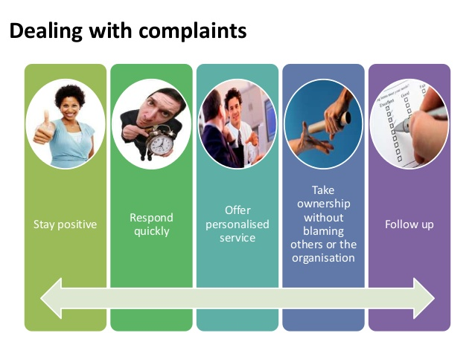
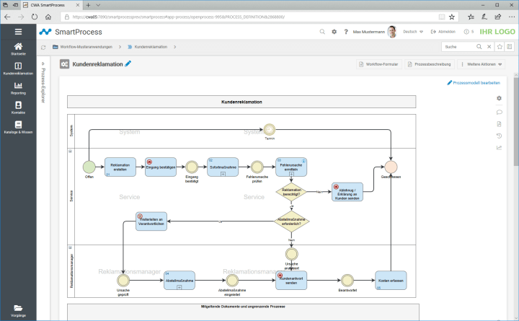
Manage Status of the Complaint
The allowed tab will help to review its complaint by its status
Open
In progress
Closed
Pending for approval

Slide 7
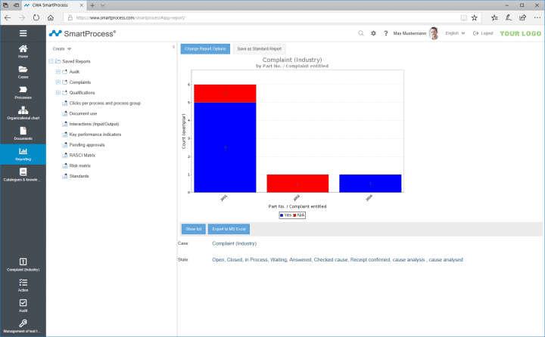
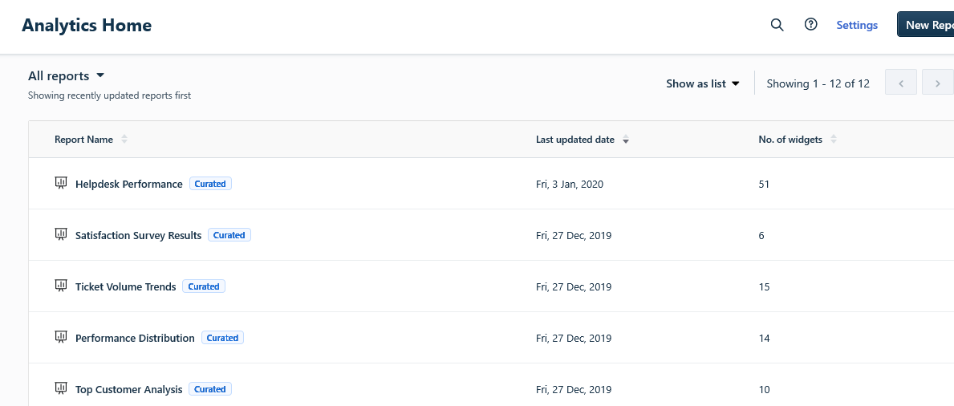
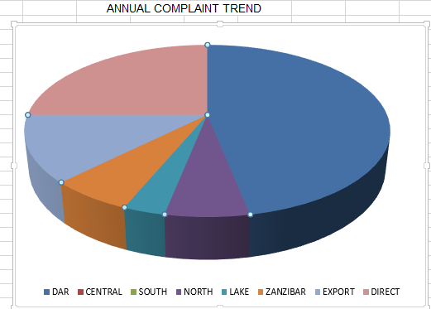
Reports and Analytical home
Report review ,
Graphs
Complaint history

Slide 8

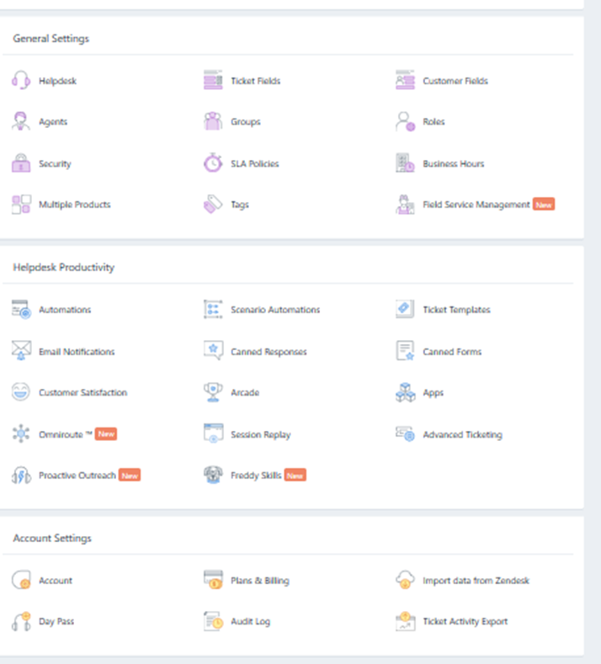
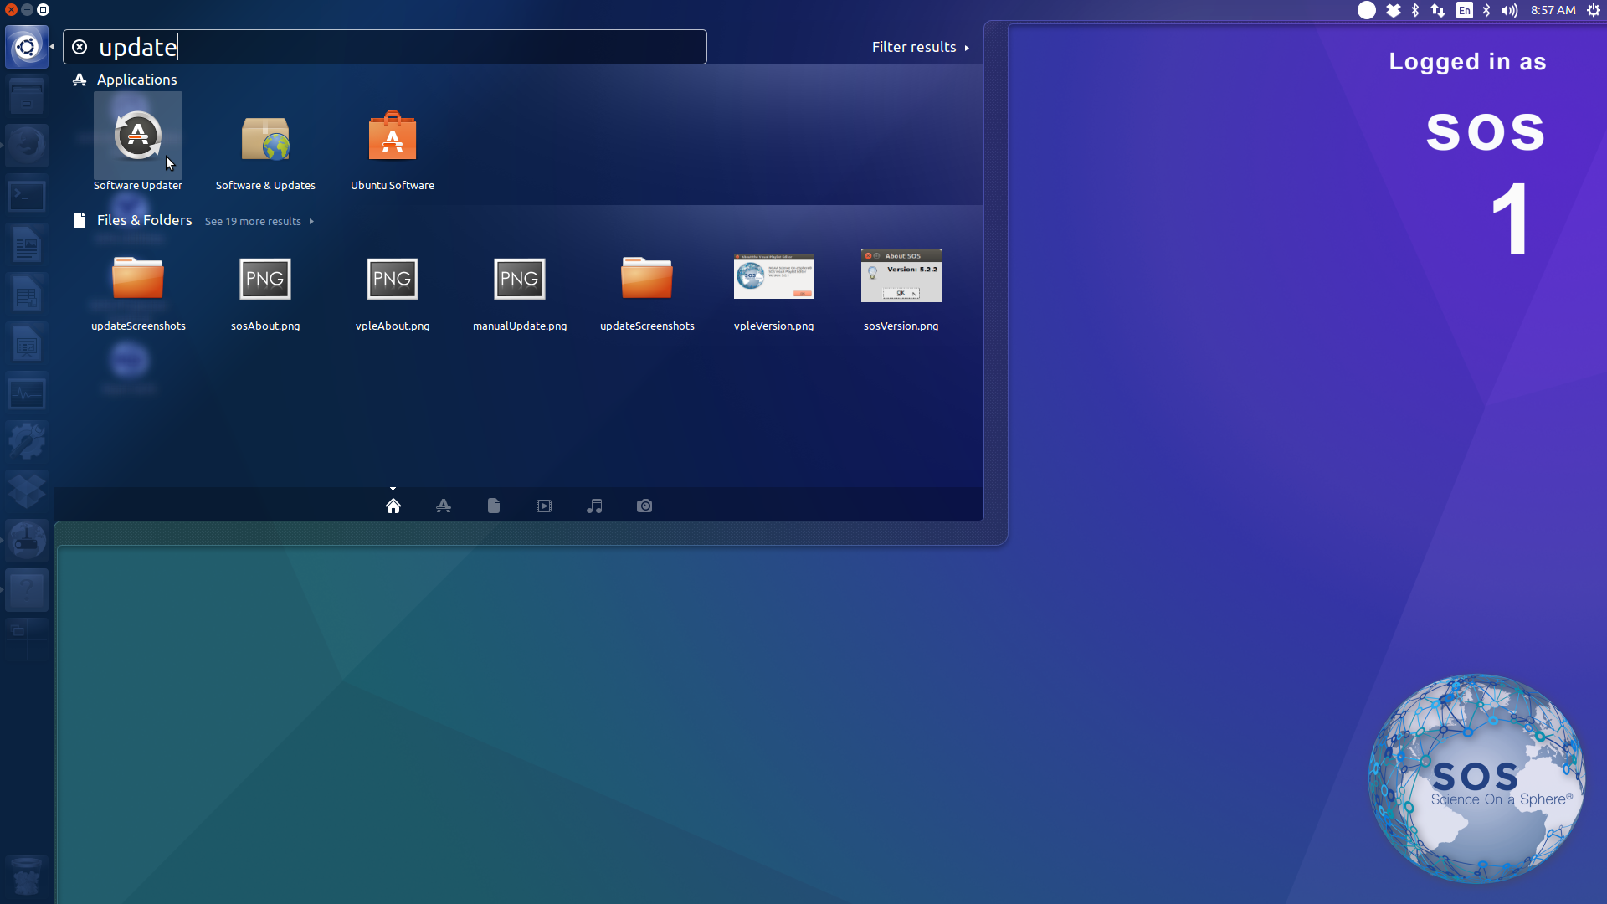
Admistration –Setup
This is to allow account setup for the users
Add contact of other users
Monitoring access to the system

